Slide 1
Source-sink hypothesis model
Urban refugia project
19/05/2024

Slide 2
Set-up
We want to test if urban areas are acting as Podarcis pityusensis sinks or, on the contrary, urban populations are self-sustainable and don’t need from immigration to persist, both before and after the arrival of snakes.
To test this, we have modelled a population and change parameters to see the effect of the introduction of snakes, emigration, and urbanisation.

Slide 3
Population parameters
Max lifespan = 18 years. After 18 years, individuals die.
Sexual maturity = 2 years. Females only lay eggs after the 2n year.
Nº eggs/laying = 2.30 ± 0.55.
Laying episodes = 1 laying per year. Old females lay 2 times (14-18 yo).
Hatching rate = 60-75% per egg.
Annual survival = 0.75-0.83.
Carrying capacity = 312 ind/ha (based on Chalets abundances)
For more info, look at the document with the references

Slide 4
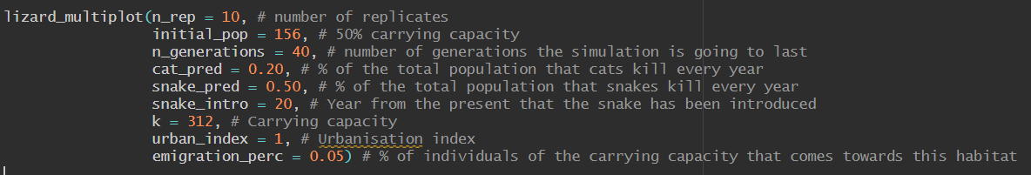
The model
Some assumptions are made in here:
In peri-urban settings, there are less cats than in urban settings, so the % of individuals killed by cats in peri-urban sites is 10% of the total populations, and in urban sites, 20% of total lizard population

Slide 5
The model
Some assumptions are made in here:
Snakes, when present, predate on 50% of the total lizard population per year. The predation event starts after some years (specified by the snake_intro parameter)

Slide 6
The model
Some assumptions are made in here:
Urbanisation index = 1 means that the urban matrix is countering the effect of snakes. If the parameter is set to 0, there won’t be any protection coming from the urban matrix

Slide 7
The model
Some assumptions are made in here:
You can have emigration from peri-urban to urban settings, and in this case is the % of individuals of the total carrying capacity.

Slide 8
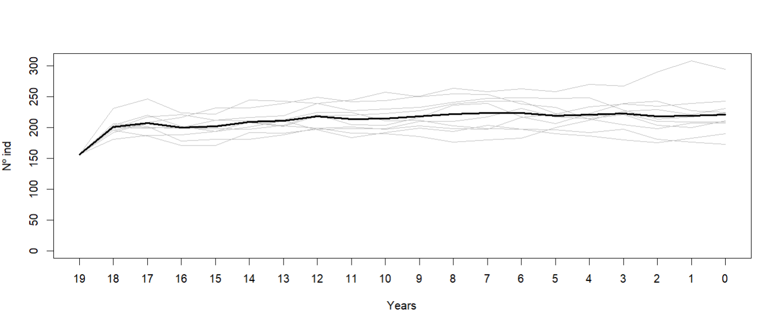
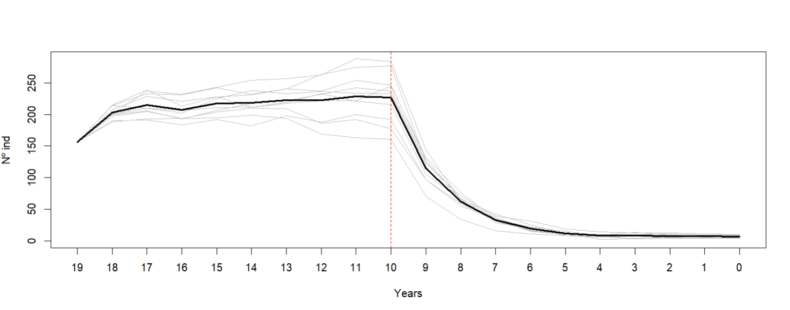
Peri-urban sites
No snake
With a cat predation of 10%, populations without snake stabilize, but once the snake is introduced, lizards dissapear
Snake

Slide 9
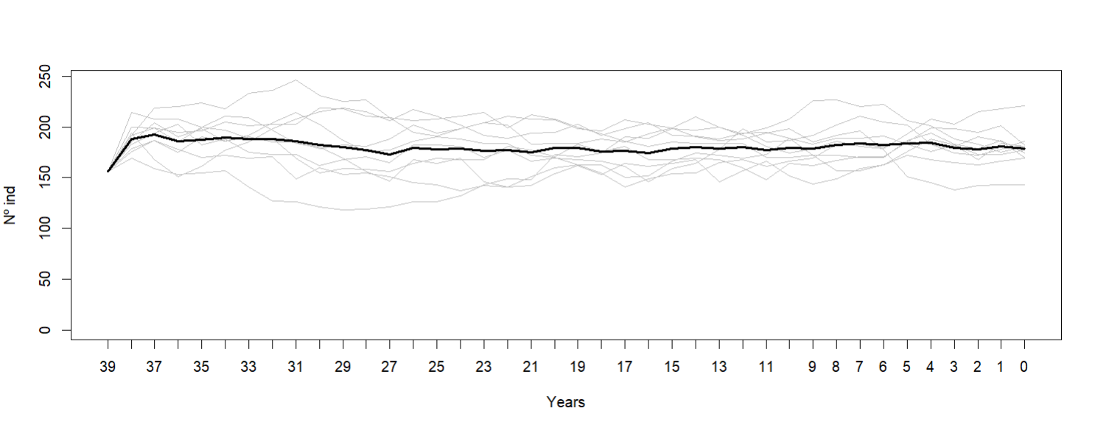
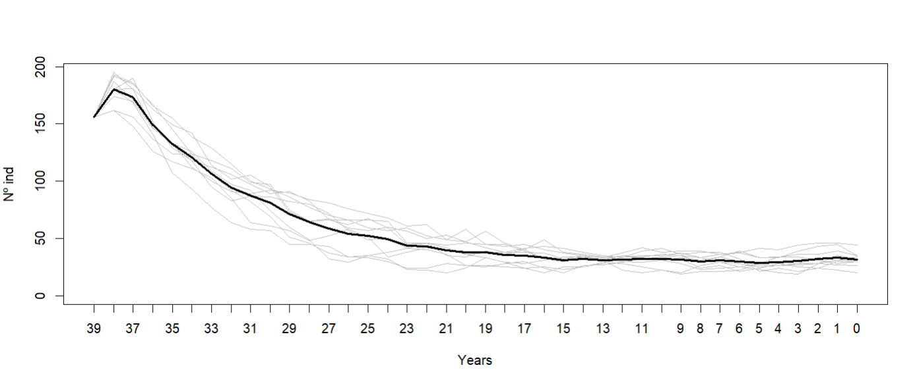
Urban sites
With a cat predation of 20%, populations without snake stabilize, although emigration allows higher densities
No snake, emigration
No snake, no emigration

Slide 10
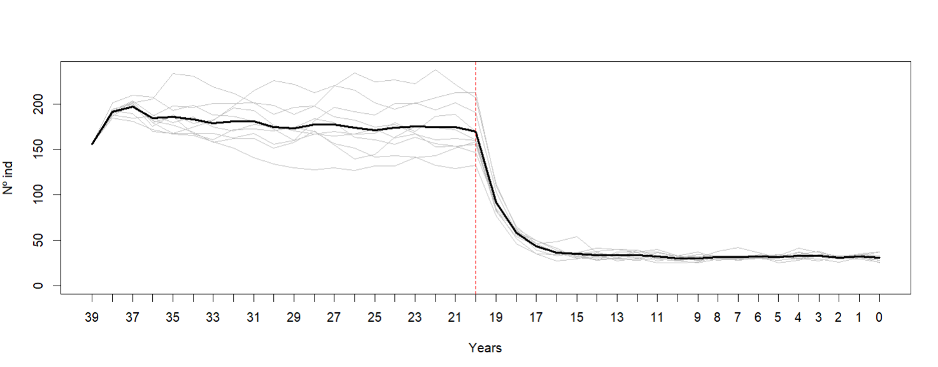
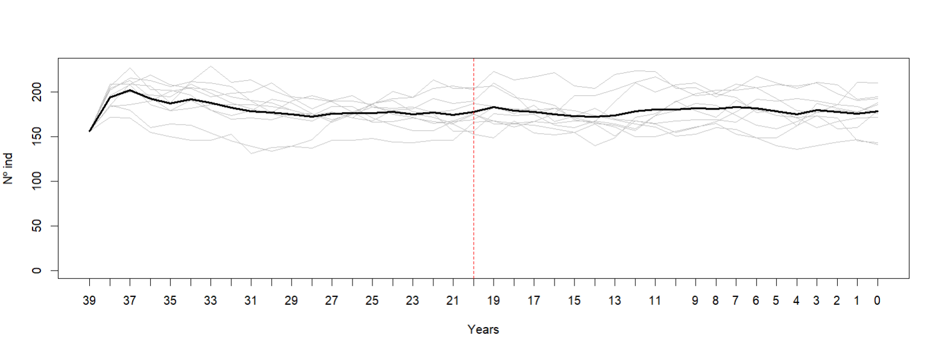
Urban sites
Snake, emigration, no urban refugia protection
With a cat predation of 20% and the introduction of snakes, if there is emigration from outside, populations can persist. The urban refuge hypothesis allows for higher abundances
Snake, emigration, urban refugia protection

Slide 11
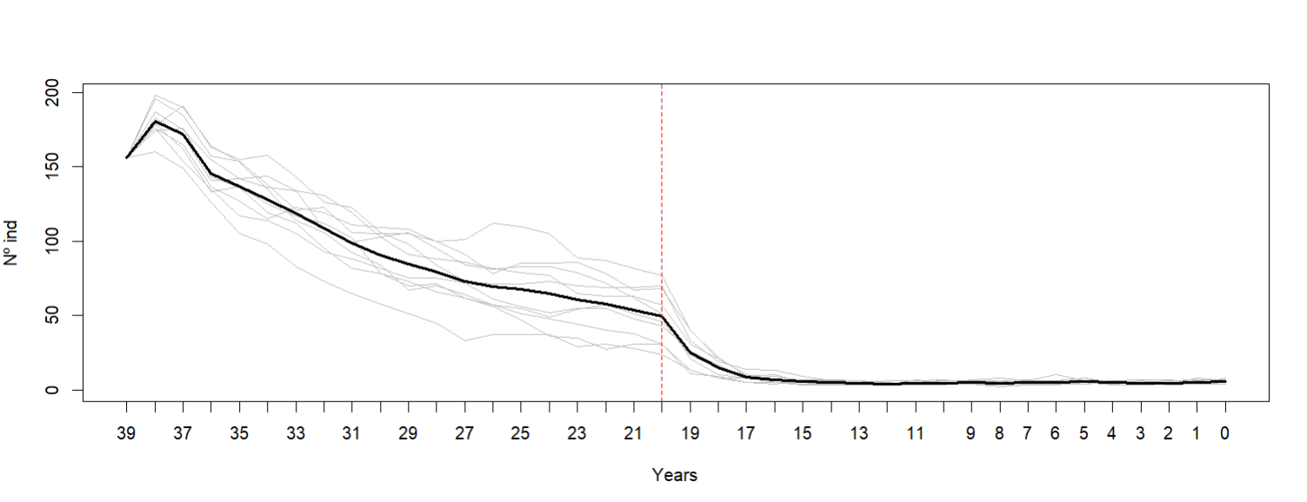
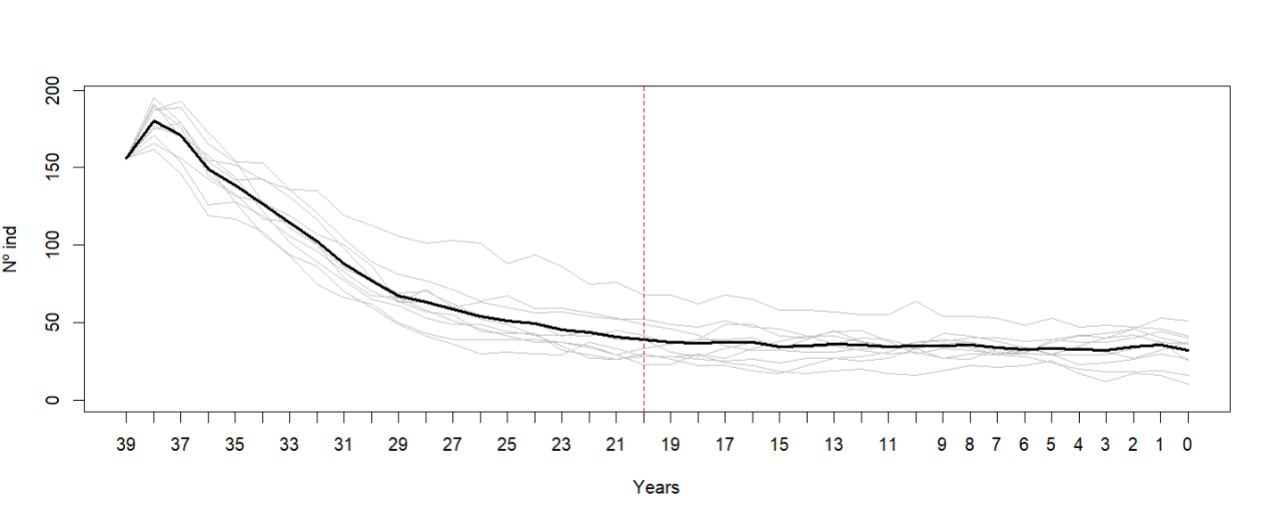
Urban sites
Snake, no emigration, no urban refugia protection
With a cat predation of 20% and the introduction of snakes, if there is no emigration from outside, populations can only persist if the urban refugia hypothesis is true.
Snake, no emigration, urban refugia protection

Slide 12
Preliminary conclusions
It is obvious that when the snake arrives to peri-urban sites, the lizard becomes extinct, so no emigration from peri-urban sites to urban sites would be expected.
If no emigrations are expected, but we still see lizards in long-time invaded areas, it must mean that urban areas are dampening the effect of the invasion of the snake. Otherwise, we wouldn’t see lizards in urban areas.

Slide 13
Important considerations
Cat predation, snake predation and emigration parameters have been decided for no specific reason. They could be changed and modified.
For the plots, it might be better to delete the nº of individuals axis and just draw a line on the carrying capacity value, as it is a theoretical model
The predation rate of cats seems to be pretty high, in it might look like urban areas are acting as sinks, but populations remain stable.
Any other comment? Some suggestions can be easily added to the model, in terms of effect of urbanisation, % of predation…

